Slide 1
Sing Like a Pianist, Play Like a Singer
Presented by Dr. Justin Binek
Associate Professor of Music, Kansas city Kansas Community College

Slide 2
Sing like a pianist? Play like a singer?
What does that mean?
The duo. The most exposed collaborative performance setting. But if the of you have complete trust in each other’s musicianship, the results can be pretty magical.
In many ways, the duo is the hardest and scariest ensemble in which to perform. There is nowhere to hide, and you and your partner have to have complete trust in each other’s musicianship and give and take throughout the course of the evening.
As singers, we need to keep the pianist’s perspective in mind.
As pianists, we need to keep the singer’s perspective in mind.

Slide 3
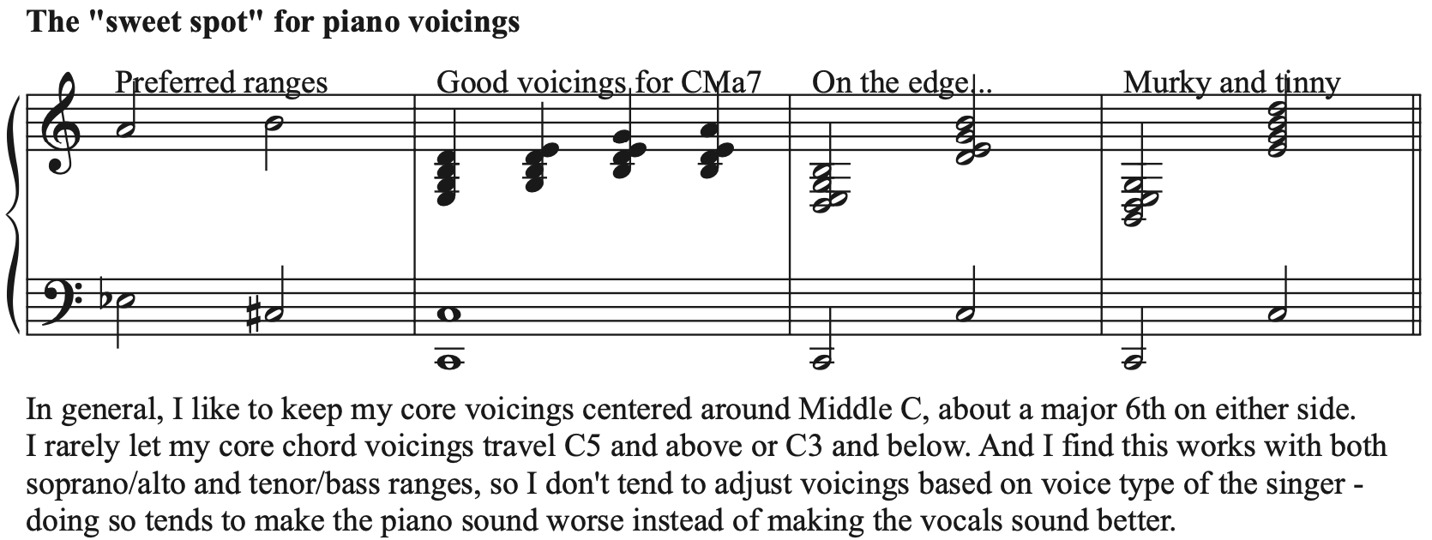
How do we provide piano support?
It all starts with finding the best voicings for the job, in my opinion.

Slide 4
Developing walking bass lines

Slide 5
Other key principles for pianists
Put walking bass lines in the bass.
Know the lyrics.
Develop a consistent set of “core voicings” that align well with the melody.
Please look at core voicings for “Our Love Is Here To Stay” on page 4 of the handout.

Slide 6
What are the singer’s responsibilities?
The first and most important thing: know the tune as well as the pianist does. Be a musician who happens to use their voice as their instrument.
Five tips for success:
#1: Make the lyric the main thing!
#2: It’s a collaboration, not a vocal showcase.
#3: Keep the alterations to a minimum, unless you’ve worked together a lot.
#4: Make eye contact and be consistent with your gestures.
#5: Know what you intend to do during piano solos.

Slide 7
Putting it all together…
Please tun to page 8 of the handout to observe ways in which the voice and piano can begin to effectively interact with each other.
Then, please look at pages 11-14 in the handout to view how an experienced piano/vocal duo might play off each other on “Our Love Is Here To Stay.”
Rubato ballads: they are awesome, and they are terrifying. It’s about give-and-take and emphasis on the lyric.
Embrace the principle of intentionality: there needs to be a reason why things are being done.
But first…

Slide 8
Dear Pianists…

Slide 9
A bit more on ballads (for pianists)

Slide 10
Bringing things to a close…
Student Demonstration Examples
Q&A
A few great piano/vocal duo albums I love
The Tony Bennett/Bill Evans Album
Ella Fitzgerald: The Complete Piano Duets
Roberta Gambarini and Hank Jones: You Are There
Jeanne Lee and Ran Blake: The Newest Sound Around
Bobby McFerrin and Chick Corea: Play
Norma Winstone and Fred Hersch: Songs & Lullabies
Thank you so much for attending! Please visit www.justinbinekjazz.com for additional educational resources, including materials from past JEN clinics!

